Slide 1
Exploring MAB and Bayesian for A/B Testing

Slide 2
PROBLEM STATEMENT
It is a synthetically simulated data based on the premise that we are running an ad campaign on a browser with two variants of ads named A(Control) and B(Treatment) .
We have divided the traffic towards both the Ads equally .
We already have generated the data with the idea that campaign B will perform better than campaign A.
The dataset was simulated for 24 days.
Click counts were randomly sampled from the triangular distribution and conversion count from the normal distribution which was then scaled by the click counts.
Total Traffic
50%
50%
Variant A
Variant B

Slide 3
Bayesian A/B Testing
Understanding the Approach
The Bayesian approach allows for the inclusion of prior information (‘a prior’) into our current analysis. The method involves three overlapping concepts:
a prior, i.e. information you have from a previous experiment. At the beginning of the experiment, we use a ‘non-informative’ prior (think ’empty’).
evidences i.e., the data of the current experiment.
A posterior i.e., the updated information you have from the prior and the evidences. This is what is produced by the Bayesian analysis.
By design, this test can be used for an ongoing experiment. When data peeking, the ‘peeked at data’ can be seen as a prior, and the future incoming data will be the evidence, and so on. This means ‘data peeking’ naturally fits in the test design. So, at each ‘data peeking’, the posterior computed by the Bayesian analysis is valid.
Crucially for A/B testing in a business setting, the Bayesian approach allows the to get the probability of the winning variant.

Slide 4
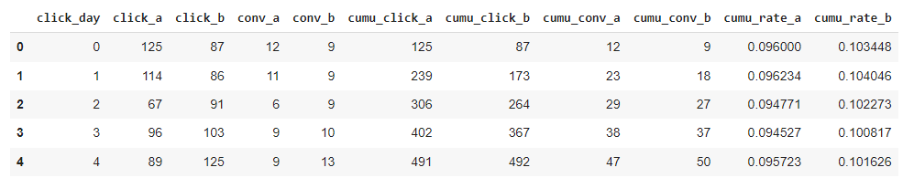
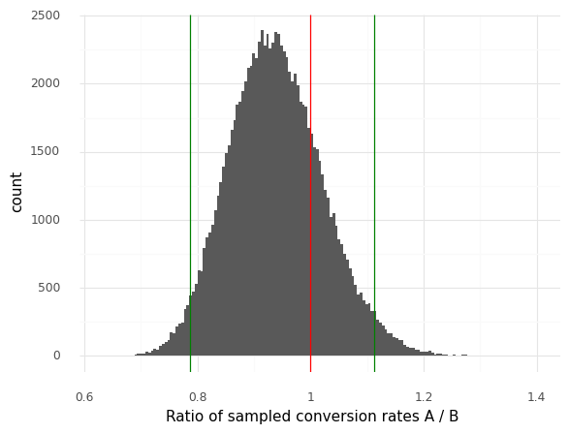
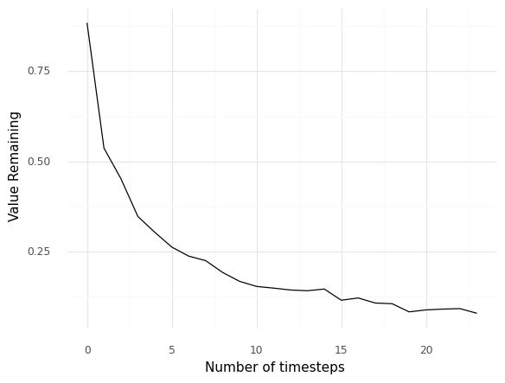
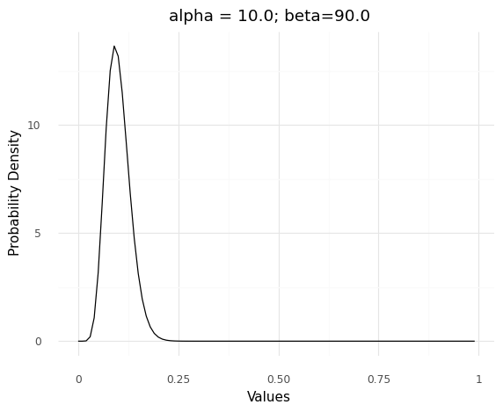
Tested Implementation
Dataset
Ratios evaluated after Sampling
Index | Campaign_Id | Clicks | Conv_cnt | Conv_per
0 | A | 2488 | 234 | 0.094051
1 | B | 2209 | 222 | 0.100498
Experimentation | Prior alpha and beta for beta distribution | result with 24 days of data eveidence
Empty prior with correct assumption | alpha = 10 beta = 90 | Variant A Rate: 9.405144694533762% Variant B Rate: 10.049796287913084% Lift for prior data = 0.645% Probability that we are seeing a 2% lift: 69.95% Probability that A is greater than B: 0.22673 Average A/B ratio: 0.939642725046079 Lift = 0.07226671891740935% Credible interval of A/B ratio: [0.78581336 1.11366875]
Prior Beta Distribution
Value Remaining
Value Remaining : 0.04

Slide 5
Use Cases
An A/B test is done to collect data with its associated statistical confidence. A business then uses the collected data, interprets it in a larger context and then decide.
The objective is to collect data in order to make a critical business decision. For example: If a company requires to end an online service, then they can test the statistical significance of the prior assumption, to derive concrete conclusions about the service.
The objective is to learn the impact of variations with statistical confidence. For example: if a website has released a web page, then they can gather information on its performance so that the next time they improve their webpage they can incorporate those learnings into developing a better web page .
5

Slide 6
Bayesian A/B testing Pros and Cons
Pros | Cons
Allows to ‘peek’ at the data during a test, so you can either stop sending traffic or switch earlier to a clear winner. | There is no tradeoff between exploitation and exploration . The loss suffered during the test period can not be improved.
If an effective prior is chosen, Bayesian A/B testing requires a smaller sample size so one can get results faster. | Initial sample is required to formulate a better prior, if the sample size is small the learning takes time.
 | When two or more variants are to be compared , testing is done between 2 variants at a time .
6

Slide 7
MAB A/B Testing
Understanding the Approach
The MAB is a group of algorithms, based on the idea of the one-armed bandit. These algorithms offer different solutions for the theoretical problem a gambler faces in the casino – “what is the least expensive and fastest way to test all of the slot machines at the casino, assuming they vary in performance”. The concept is “testing as you go”, as opposed to running an A/B test with a clear start and endpoint. In MAB, the test is ongoing, operating continuously throughout the campaign.
A simple MAB experiment can be configured by the following steps:
Define Arms — Create an Experiment and Specify the Arms for the Experiment
Define Environment— Define the environment of experimentation with metrics to be maximized.
Serve Experiment — Experiment gets served. Traffic is distributed and the Arms with higher returns get more traffic.
Update Arms — Reward function or Posterior reward distribution of each arm is updated .

Slide 8
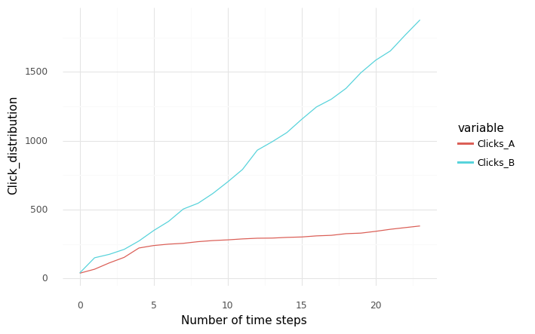
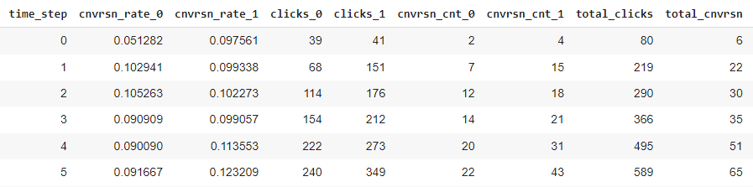
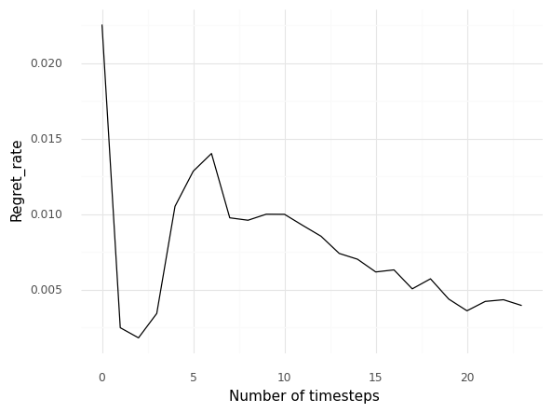
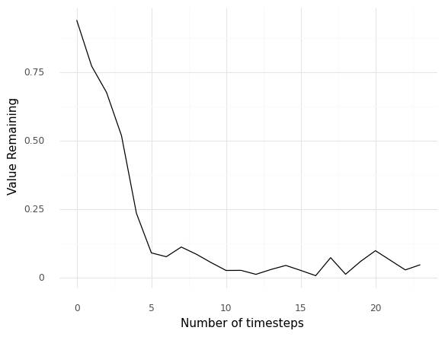
Tested Implementation
Dataset
Cumulative clicks
Regret Rate
Value Remaining
Value Remaining : 0.04

Slide 9
Metrices
Value Remaining : From the posterior distribution generated from the evidence so far . Random samples are generated for both treatment and control and for each sample the maximum conversion is evaluated and subtracted from the conversion rate of the one with better average conversion rate , let's say , 4 samples of conversions were generated for both treatment and control from their posterior distribution such that average of treatment is better than control . Now we will subtract, in each sample the maximum conversion obtained from the two samples of treatment and control consecutively from the conversion obtained by treatment in that sample , by subtracting from the complete sample space we can evaluate the probability that the difference was greater than zero. Thus setting up a threshold to pick one arm consistently which is performing better , gives us the idea that one of treatment and control is performing better and the probability of its occurrence from the generated samples.
Regret Rate : It measures the loss incurred due to not diverting the whole traffic towards which ever of control and treatment performs better . In other words , if treatment has higher conversion after the analysis of current time step then it will measure the loss for all the people who were sent to control instead of treatment .

Slide 10
Use Cases
MAB is an optimization algorithm that maximizes a given metric .There’s no intermediate stage of interpretation and analysis as the MAB algorithm is adjusting traffic automatically.
Objective is to maximize conversion in less time with less data. For example, if you’re testing creatives with new features dedicated to Halloween or Christmas and offer some bonuses to users who will download your game or app during this period, you don’t have much time for gathering statistically significant results, so it is better to resort to MAB.
Objective is to maximize conversion even while testing . For example, imagine you’re selling diamonds (or a car) online. Each lost conversion is probably worth thousands of dollars in lost opportunity . In that case, MAB’s focus on maximizing conversions is a perfect fit for your website optimization needs.
10

Slide 11
MAB A/B testing Pros and Cons
Pros | Cons
Trade-off between exploration and exploitation , that is along with exploring the best arm in long term it also reduces the loss incurred during test. | Relatively slower to reach statistical significance
It doesn’t require large sample size to initialize and learning of the model is faster . | It is a continuous process without any intermediate analysis and doesn’t provide options to take decisions manually .
It can evaluate multiple variants at a time.
It can act as an extension of Bayesian A/B testing where posterior distribution is improved with each time step .
11

Slide 12
Future Work
Testing MAB with larger time steps
Testing MAB with more than 2 variants and different scenario with different metrices.
Simulating Bayesian as in MAB with manual progressive change is traffic distribution.
As MAB already carries on the maximization of the metrics , it still randomly distributes the campaigns irrespective of the context of the audience it is sending the campaigns to .
We can personalize this experience for the user which can maximize the metrices further towards profitability .
For example, multiple variants of an ad were released in a website for very short period of time and the cost of releasing the campaign as well as not getting conversions are too high , and the frequent confusion in performance of each ad is due to the content of the ad being used and their suitability with each user . In this scenario we can maximize the profit by instead of picking the best variant choosing the variants based on the context of the user .

